Slide 1
GUI-Based Scientific Calculator
Java College Project Presentation
By: M.shashi kiran(24070721019)
D.ajay(24070721011)
T.sainivas(24070721041)
A.shashank(24070721001)
M.Aditya(24070721018)
Department of Computer Science

Slide 2
Introduction
A scientific calculator is a software application designed to perform mathematical operations beyond simple arithmetic. This project implements a GUI-based scientific calculator in Java using Swing components to provide an interactive and user-friendly interface
2

Slide 3

Objectives
•To design and develop a GUI-based scientific calculator using Java.
• To implement essential mathematical and trigonometric operations.
• To ensure accuracy, usability, and reliability of the application.
• To enhance programming and GUI development skills.
3

Slide 4
Problem Statement
•Manual calculation of complex mathematical expressions can be time-consuming and error-prone. Hence, there is a need for a software-based solution that provides accurate and efficient computation with a user-friendly interface.
4

Slide 5

Scope of the Project
• The calculator supports both basic and advanced mathematical operations.
• Includes trigonometric, logarithmic, and exponential functions.
• GUI allows easy interaction and improved visualization of operations.
• Portable and platform-independent through Java.
5

Slide 6
Tools and Technologies Used
• Programming Language: Java
• GUI Framework: Swing
• IDE: Eclipse / NetBeans / IntelliJ IDEA
• Operating System: Platform Independent
• JDK Version: 8 or above
Brainstorm
User Feedback
6

Slide 7

System Design
•The system follows a modular design approach:
• Input Module – Accepts user inputs via buttons.
• Processing Module – Performs computations using Java logic.
• Output Module – Displays results on the screen.
• Error Handling – Manages invalid inputs and exceptions.
8

Slide 8
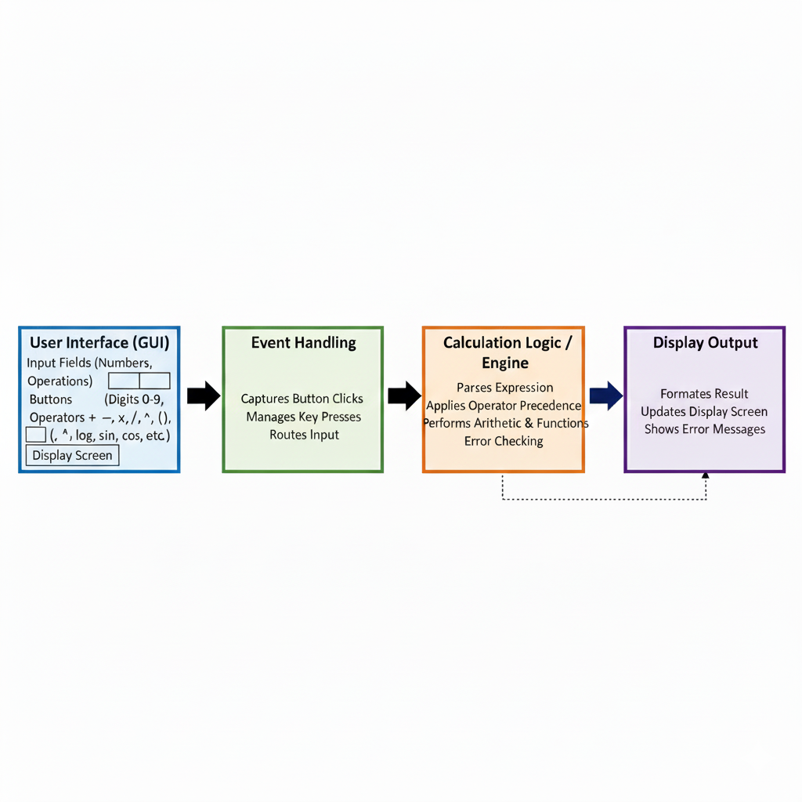
Architecture Diagram
9

Slide 9
GUI Layout
Team A
•The GUI consists of:
• Display Screen for showing input/output.
• Buttons for digits, operators, and scientific functions.
• Menu options for clearing, exiting, or additional settings.
GUI Layout
10

Slide 10
Implementation
• The calculator is implemented using Java Swing.
• ActionListeners are used for handling button events.
• Mathematical operations are performed using Java Math class.
• Exception handling ensures smooth functioning of the application.
11

Slide 11
Sample Code Snippet
JButton btnAdd = new JButton("+");
btnAdd.addActionListener(new ActionListener() {
public void actionPerformed(ActionEvent e) {
num1 = Double.parseDouble(textField.getText());
operator = '+';
textField.setText("");
}
});
12

Slide 12
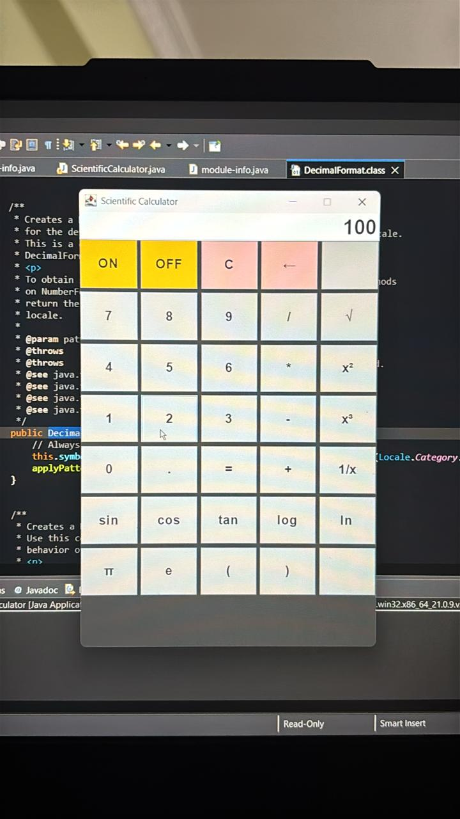
Output

Slide 13
Advantages
• Easy to use and user-friendly GUI.
• Fast and accurate calculations.
• Supports advanced scientific operations.
• Cross-platform compatibility using Java.

Slide 14
Limitations and Future Scope
Limitations:
• No support for graph plotting.
• Limited memory functions.
Future Enhancements:
• Add support for graphing and history storage.
• Include dark mode and voice input features.

Slide 15
Conclusion
The GUI-based Scientific Calculator developed in Java provides a reliable and efficient solution for performing mathematical operations. It demonstrates the practical application of Java Swing, event handling, and software design principles in a real-world context.

Slide 16
Thank You

